Slide 1


HUM 102 Report Writing Skills
Lecture 05

Slide 2

Previous Lecture
Discussions
Findings
Conclusions
Recommendations
Appendices

Slide 3

Types of Report
Formal
Informal

Slide 4

Informal Report
Information
Analysis
Recommendation
Short-length and particular formality
Deals with everyday problems and issues
Usually written for readership within an organization

Slide 5


Types of Informal Report
Personnel Evaluation
Financial Report
Feasibility Report
Literature Review
Credit Report
Sales Activity
Progress Report

Slide 6
Types of Informal Report
Sales Activity: sales person
Progress Report: science, reporting a funding agency
Personnel Evaluation Report: performance assessment
Financial Report: financial statement, financial activities
Feasibility Report: evaluates solutions of a problem
Credit Report: information regarding your way of handling debt

Slide 7
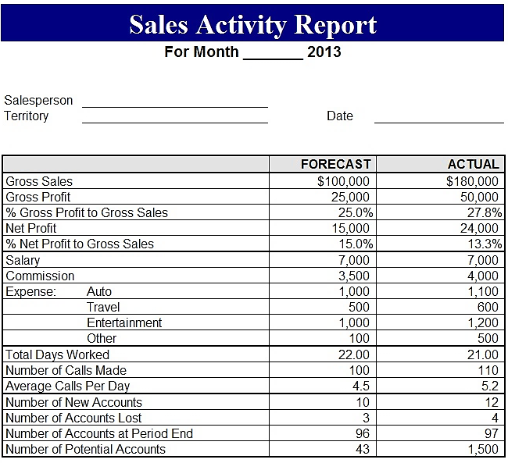
Sample Sales Activity Report

Slide 8
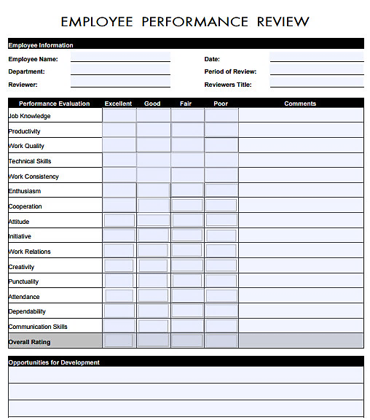
Sample Personnel Evaluation Report

Slide 9
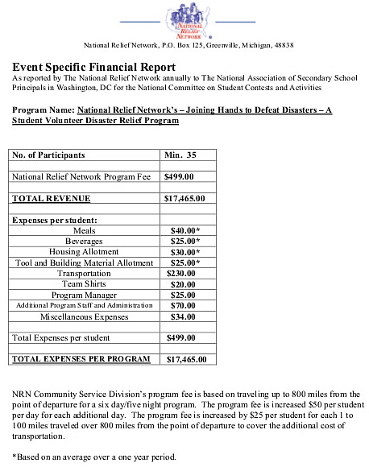
Sample Financial Report

Slide 10
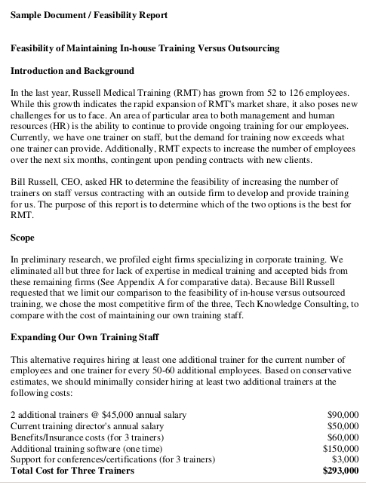
Sample Feasibility Report

Slide 11
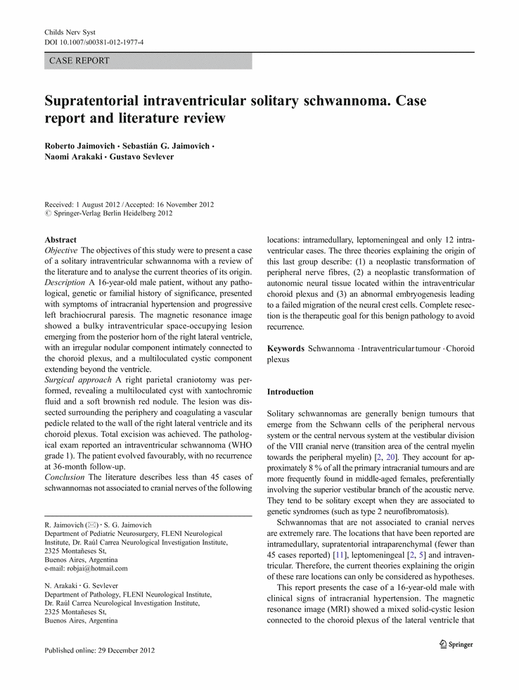
Sample Literature Review

Slide 12
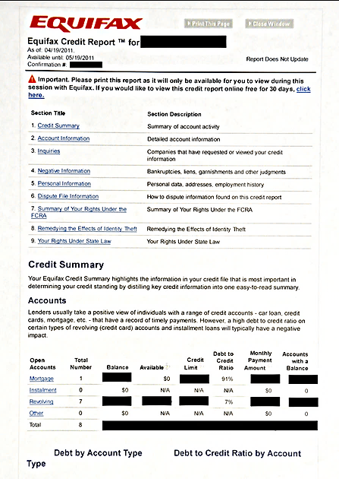
Sample Credit Report

Slide 13
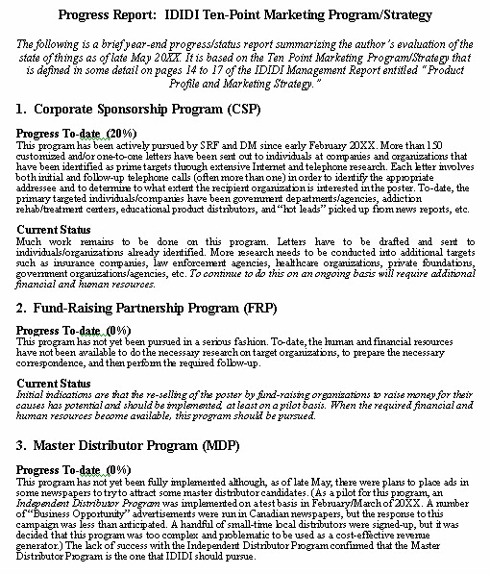
Sample Progress Review

Slide 14

Formal Report
Collection and data interpretation
Complex form of report
Written account of a major project
Long and detailed
Review, results of a study

Slide 15

Formal Report’s Categorization
Informational
Analytical
Recommendation

Slide 16

Informational Report
Statuses
Updates
Mechanisms
Results
Focus remains on the outcomes
Report on bills

Slide 17
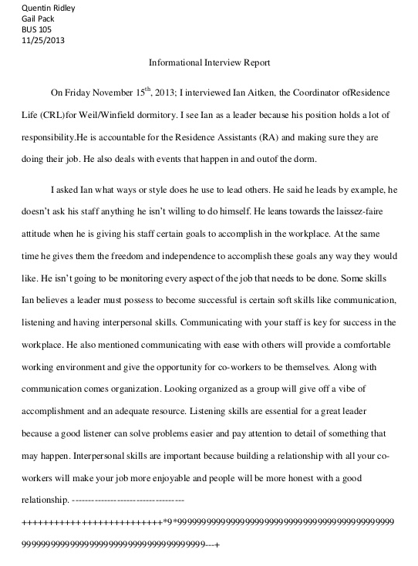
Informational Report Sample

Slide 18
Analytical Report
Analysis of outcome to draw conclusion
Focus is on the interpretation of what happened
Results
Report on traffic accidents
Leading towards suggestions

Slide 19
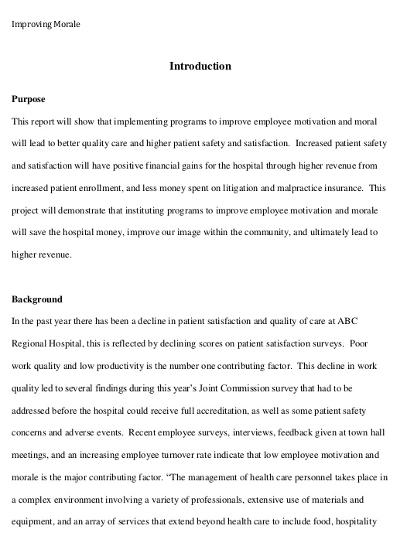
Analytical Report Sample

Slide 20
Recommendation Report
Advocates a particular course of action
Presentation of results supporting recommendation
Similar to analytical report. However…
Analyzing an action is not the same as recommending it

Slide 21
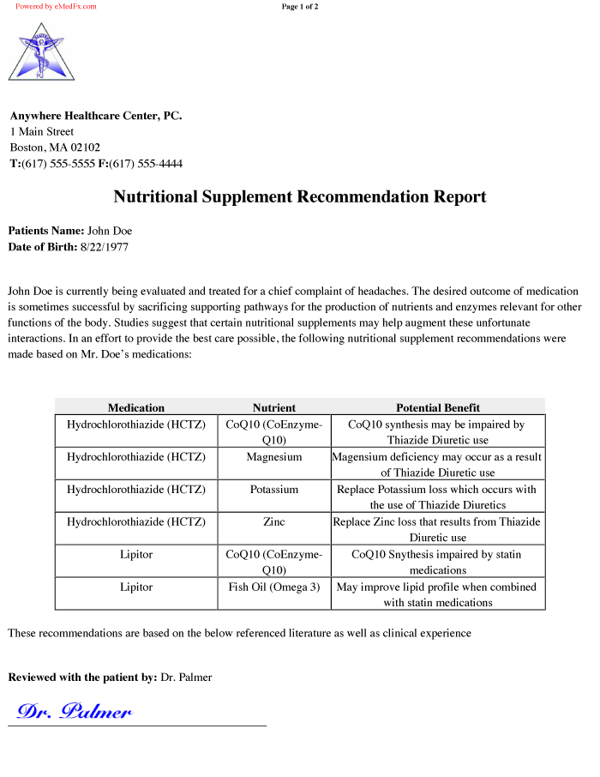
Recommendation Report Sample

Slide 22
Additional Forms of Report
Narrative Report: logical sequence (case studies)
Specialized Report: summary of reports regarding a problem
Accident Report: documentation, investigation
Non-chronological Report: discussion of different aspects regarding a subject; non fiction book

Slide 23
Additional Forms of Report
Narrative Report: logical sequence (case studies)
Specialized Report: summary of reports regarding a problem
Accident Report: documentation, investigation
Non-chronological Report: discussion of different aspects regarding a subject; non fiction book

Slide 24
Additional Forms of Report
Narrative Report: logical sequence (case studies)
Specialized Report: summary of reports regarding a problem
Accident Report: documentation, investigation
Non-chronological Report: discussion of different aspects regarding a subject; non fiction book

Slide 25
Additional Forms of Report
Narrative Report: logical sequence (case studies)
Specialized Report: summary of reports regarding a problem
Accident Report: documentation, investigation
Non-chronological Report: discussion of different aspects regarding a subject; non fiction book

Slide 26
Additional Forms of Report
Narrative Report: logical sequence (case studies)
Specialized Report: summary of reports regarding a problem
Accident Report: documentation, investigation
Non-chronological Report: discussion of different aspects regarding a subject; non fiction book

Slide 27
Conclusions
Types of report
Informal report and its types
Formal report and its types
Additional forms of report

